Slide 1
FINAL PROJECT C++
DEIVINA VISVANADAN A17DW3390
ANUSIA GUNALAN A17DW2393

Slide 2
DIPLOMA STUDENTS INFORMATION SYSTEM
IF ELSE
LOOPS
SWITCH
STRUCT
FUNCTIONS

Slide 3
OBJECTIVE
ONE OF THE EASY WAY TO CALCULATE CGPA .
CAN SHORT LIST THE INFORMATION ABOUT STUDENTS.
CAN FIND INFORMATION QUICKER.

Slide 4
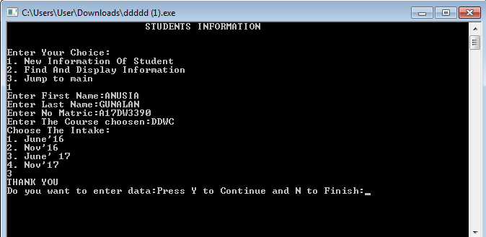
PART 1

Slide 5
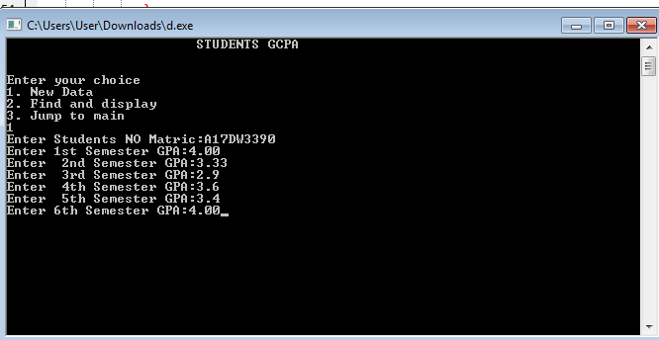
PART 2

